Slide 1
Validating a Threat Model for Smart Home Gateways
Candidate: Antonino SANTA ROSA
Supervisors: Prof. Fulvio CORNO, Dott. Luca MANNELLA
Master’s Degree in Computer Engineering Department of Control and Computer Engineering Politecnico di Torino

Slide 2
Outline
Background
Reference Threat Model
Developed Proofs of Concept
Validations
Conclusions

Slide 3
Background

Slide 4

Smart Homes
A possible definition of Smart Home:
IoT residential environment where heterogeneous electronic devices are networked together to provide services to individuals.

Slide 5
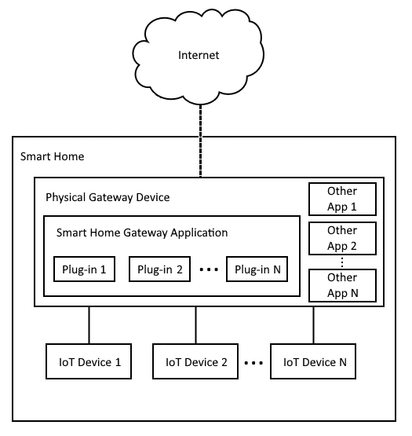
Smart Home Gateways (SHG)
The Smart Home Gateway (SHG) is a device, or a software solution, that acts as the Smart Home’s control center:
Monitor and control the networked devices within the Smart Home’s environment
Some SHGs are also extensible by means of add-ons that provide additional functionalities to the Smart Home components.

Slide 6

WebThings
Examples of extensible, non-commercial, and open-source SHGs are:
WebThings;
Home Assistant;
openHAB.
The SHG target of evaluation of the thesis was WebThings:
Born in Mozilla and then released as an independent open-source project;

Slide 7

Threat Modeling
Threat modeling is essential in the field of cybersecurity and risk management
It permits to anticipate and mitigate potential risks by proactively identifying threats and vulnerabilities
Improves the overall security in systems, applications, and organizations

Slide 8
Reference Threat Model & Developed Proofs of Concept

Slide 9
Reference Threat Model
A Threat Model for Extensible Smart Home Gateways - Corno, Mannella
It considers threats originated from add-ons
It aims to help developers understanding possible attacks against the system and not develop add-ons for SHGs that act like the presented ones
Add-ons’ scope:
Set of variables, files, or resources that the add-on can legitimately access

Slide 10
Reference Threat Model
The attack targets referred by the threat model can be:
Another add-on, devices controlled by the SHG, the SHG application itself, applications running alongside the SHG, and the gateway’s operating system.
The model currently identifies 11 threats coming from add-ons:
In this thesis, I focused on the first eight threats of the model.

Slide 11
Threat #1, #2
T1: an add-on accesses and uses private data outside its scope, hence belonging to an attack target
T2: an add-on accesses data outside its scope that belong to the attack target, and then it spreads these data
They breach confidentiality:
→ Unauthorized disclosure of information
They were implemented through the same add-on

Slide 12

T1 & T2 – PoC
The add-on provides the SHG with a virtual weather station
The user needs an API-Key to query the weather provider
The add-on, due to a typo, uses a data path to retrieve the API key that is slightly different from the one it should use:
It will use the API key of another add-on, resulting in T1.
It will spread the API key of the other add-on by backing it up on Dropbox, resulting in T2.

Slide 13
Threat #3
T3: an add-on alters the state of Smart Home devices that are not supposed to be in its scope
It breaches integrity:
→ Unauthorized modification or destruction of information

Slide 14
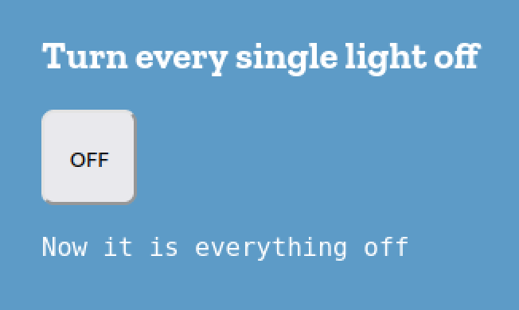
T3 – PoC
Add-on meant to turn off every light within the Smart Home environment.
The code misses a filtering function that would filter from the list of devices to turn off only the lights.
Thus, it turns off every device having an on property and not only lights, resulting in T3.

Slide 15
Threat #4
T4: an add-on alters private data of an attack target
It breaches integrity

Slide 16
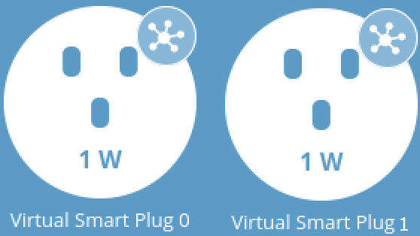
T4 – PoC
Add-on that integrates up to two smart plugs in the SHG
It periodically collects on file the instantaneous power consumption of each plug
The code does not assign a unique identifier to the files corresponding to each plug.
Thence, the slowest plug that writes on file will overwrite the file of the other one, resulting in T4.

Slide 17
Threat #5
T5: an add-on delays the regular functionalities of an attack target
It breaches availability:
→ Impossibility of ensuring timely and reliable access to and use of information or a system

Slide 18
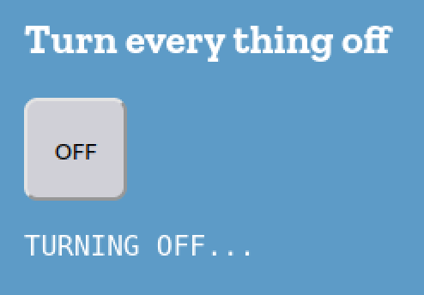
T5 – PoC
Add-on meant to turn off every device within the Smart Home
Even when the selected component is not a device, the last selected device receives a request to be turned off.
This behaviour is iterated until a new device is reached.
Trying to turn on the device while receives requests to keep it off will not be temporarily effective, resulting in T5.

Slide 19
Threat #6
T6: an add-on alters one of the regular functionalities of an attack target
It breaches availability

Slide 20
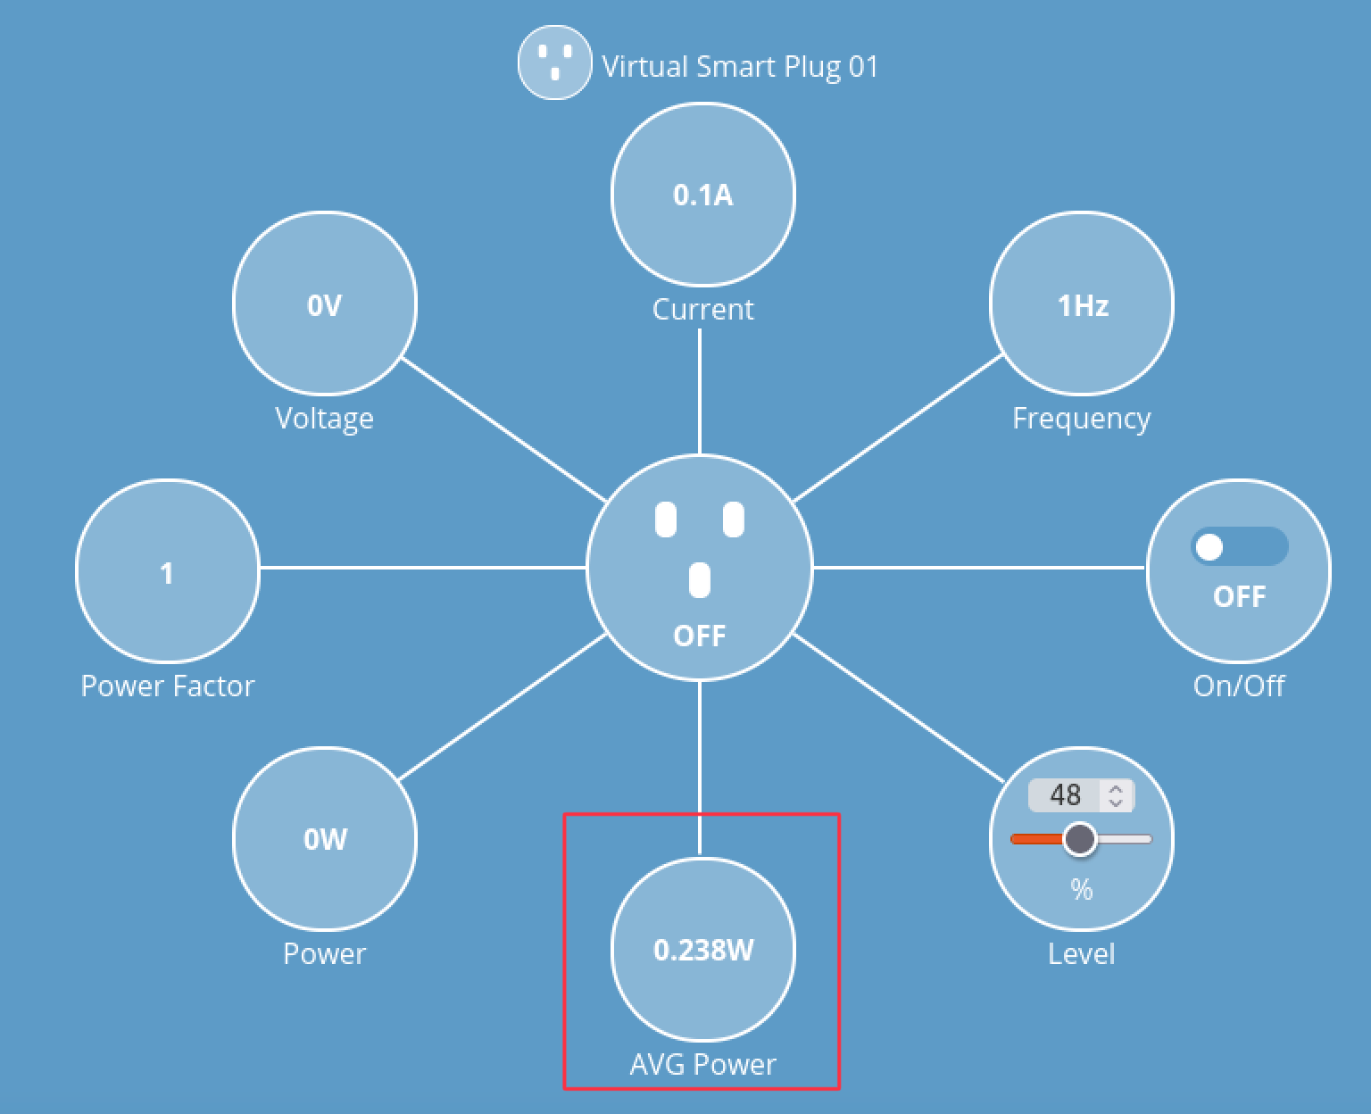
T6 – PoC
Add-on that integrates a smart plug in the SHG and regularly stores on file its instantaneous power consumption data
To show its average power consumption in the dashboard
The data path written in the code slightly differs from the correct one and corresponds to another add-on’s path
The average power consumption output in the dashboard will be wrong for both the add-ons, resulting in T6.

Slide 21
Threat #7
T7: an add-on alters the regular functionality of an attack target, preventing Smart Home users from using it
It breaches availability

Slide 22
T7 – PoC
Add-on was designed to turn off every Smart Home’s device.
An infinite loop keeps turning off the last device to turn off
Users will not be able to turn and leave on that last device because it will be turned off again a few moments later, resulting in T7.

Slide 23
Threat #8
T8: an add-on physically damages an attack target in the Smart Home
It breaches availability

Slide 24

T8 – PoC
The add-on every 15 minutes, stores in a file the instantaneous power consumption data of a smart plug
The argument of the function that represents the time delay is not (15*60*1000ms) 15 minutes but 15 seconds
This can accelerate by 60 times the breakdown of the device’s flash memory and the memory fill time

Slide 25
Validation

Slide 26
Surveys
To validate the Proofs of Concept (PoCs) two online surveys were conceived with different goals and aiming at different populations of respondents for skills and experiences:
A survey for a small group of experts
A survey for a larger population of users

Slide 27
Experts Survey
Goal: demonstrate the PoCs could have been developed by inexperienced programmers
Experts belonging to the e-Lite research group
Having a background in studying novice developers
Experts evaluated the found issues in the PoC scoring them from 1 to 5 (likert scale)
The higher the evaluation of the snippet, the higher the confidence that the problem is a development error without malicious intent

Slide 28
Results
Threat | Times it was spotted | Average score
T1 | 4 | 3
T2 | 5 | 3.8
T3 | 4 | 3.5
T4 | 4 | 4.75
T6 | 5 | 3.4
T7 | 5 | 3.8
T8 | 3 | 4.33
Every PoC obtained a score greater than the minimum threshold of 3 and was selected for the next stage of evaluation, i.e., the user study

Slide 29
User Study
Each survey contains:
Four snippets, two of them containing the threat occurrence
Background questions

Slide 30
Results: Obtained Compilations
 | Compilations
Total | 182
Partial | 157
Full | 25
No consent | 2

Slide 31
Results: PoCs’ evaluation
Threat | Respondents | Claimed founds | Actually founds | Labeled as intentional
T1 | 4 | 1 | 0 | -
T2 | 5 | 0 | - | -
T3 | 4 | 2 | 1 | 0
T4 | 5 | 2 | 1 | 0
T5 | 9 | 3 | 0 | -
T6 | 9 | 2 | 0 | -
T7 | 5 | 2 | 0 | -
T8 | 5 | 0 | - | -

Slide 32
Results: Participants’ Background
Nationality | Participants
Italians | 18
Indians | 2
Iranian | 1
Canadian | 1
Polish | 1
Average years of programming experience | 4.65
Average level of confidence from 1 to 5 with JavaScript | 2.9

Slide 33
Results: Participants’ SHGs knowledge
WebThings | Participants
Never heard about it | 16
Use other SHGs (e.g., Amazon echo, Hass) | 4
Just heard of it | 3
Have heard about other SHGs | 10
Regularly use it | 1
Used in the past | 1
Have developed add-ons for a SHG (Hass) | 1

Slide 34
Conclusions

Slide 35
Conclusions
Expert survey results:
→ the ideas behind the PoCs presented were solid
User study:
→ confirmed the solidity of the PoCs
We can state that the guidelines expressed in the reference threat model can be applied to modern extensible SHGs like WebThings
The discussed threats are indeed plausible in code developed by inexperienced developers
Using the threat model as a reference while developing add-ons for a SHG should be encouraged as a good practice

Slide 36
Thank you for the attention
Any question?

Slide 37
Threat Modeling
A threat model is typically realized by looking at the system to assess as an adversary would
Four main phases:
Asset Identification;
Threat Enumeration;
Threat Prioritization;
Mitigation;
Notes:
Non so se tu la abbia già provata e abbia verificato che stai nei tempi ma, considerando che hai tante cose da dire penso che questa sia una slide che puoi tranquillamente tagliare…
Cerchiamo di essere focalizzati sullo scopo della presentazione (che è il tuo contributo).

Slide 38
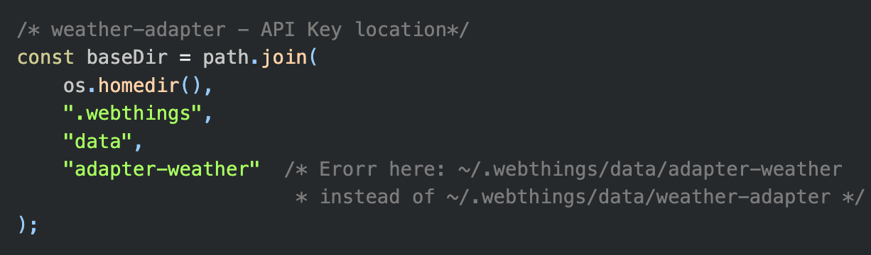
T1 & T2 – PoC

Slide 39
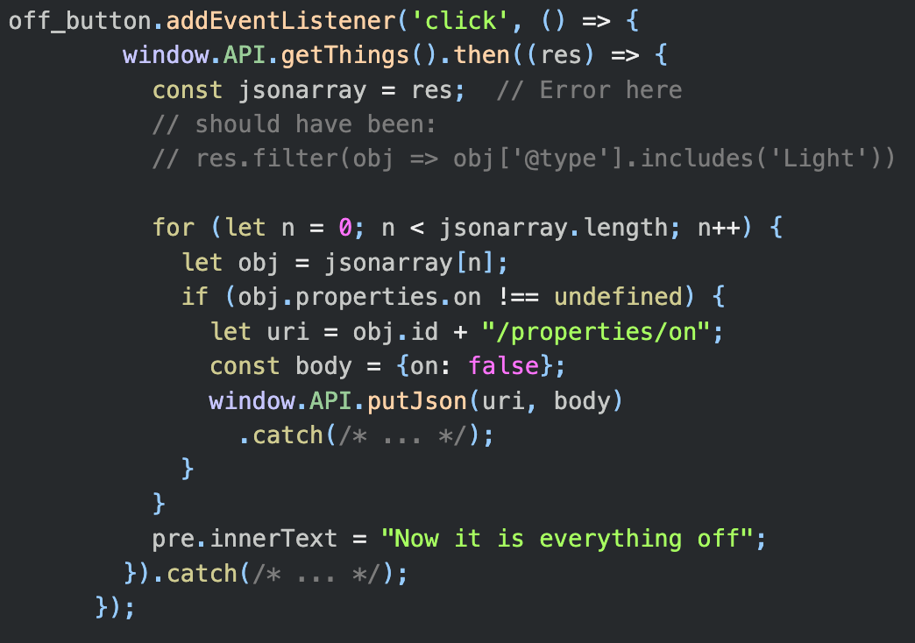
T3 – PoC

Slide 40
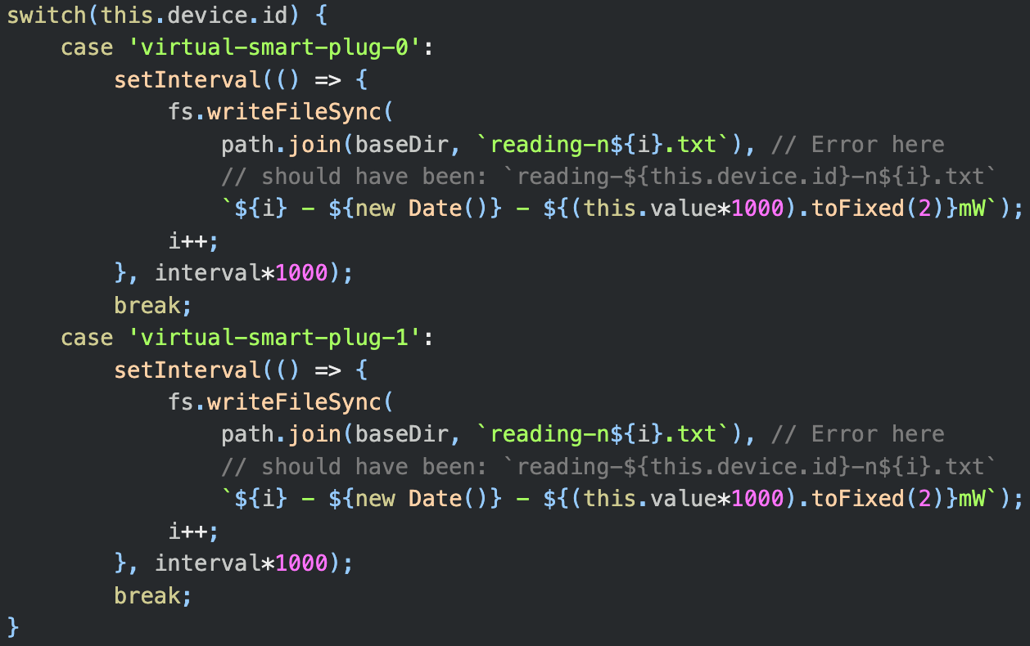
T4 – PoC

Slide 41
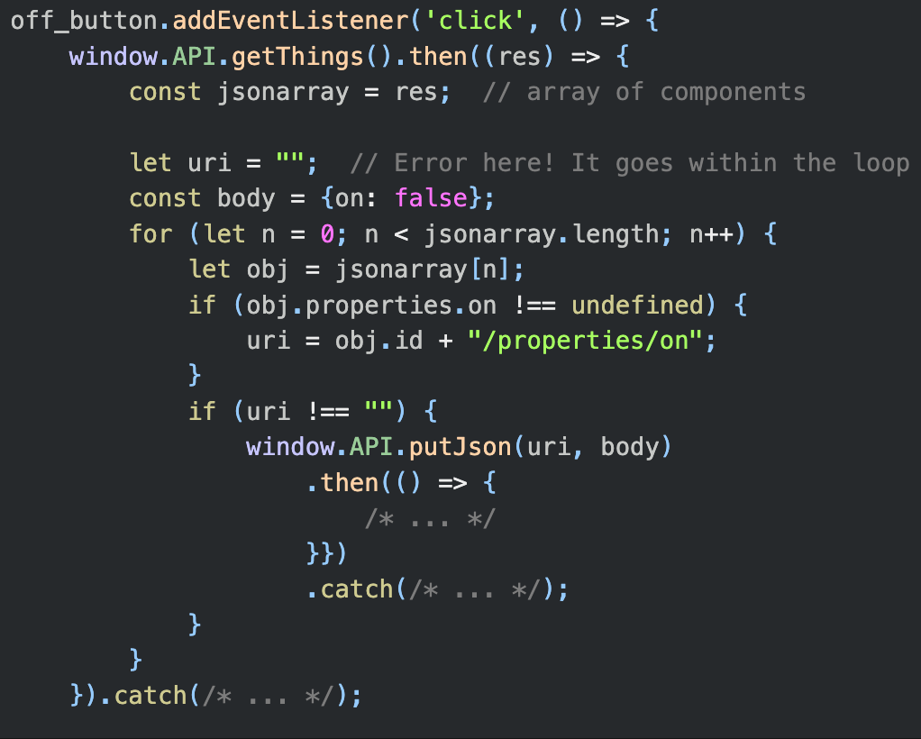
T5 – PoC

Slide 42
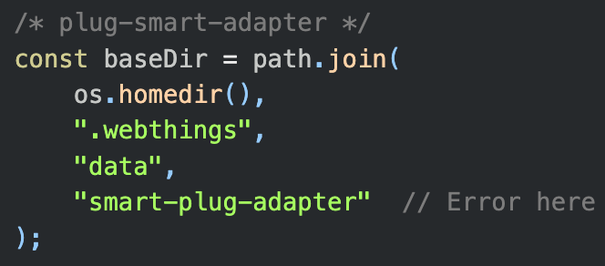
T6 – PoC

Slide 43
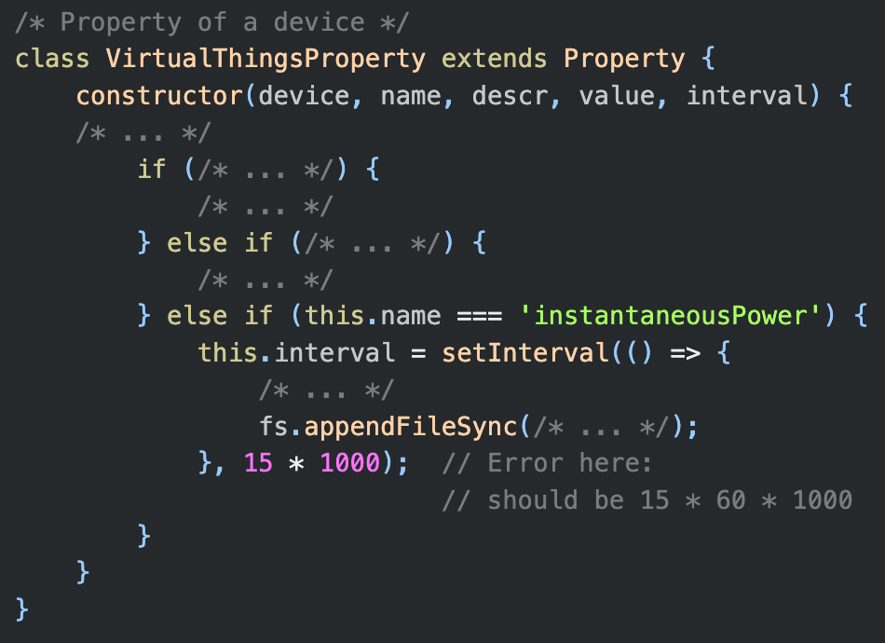
T8 – PoC

